Slide 1
Maine Association of Planners in a World of Change

Slide 2
PRE-1968
1916 | First citywide zoning ordinance in U.S. enacted (in New York City)
1919 | First “comprehensive plan” prepared at a municipal level in Maine
1925 | First Maine legislation enabling local zoning but limited to cities over 35,000 and village corporations
1926 | U.S. Supreme Court upholds zoning as constitutional (Amherst Realty v Village of Euclid)
1926 | U.S. Department of Commerce publishes model Standard Zoning Enabling Act
1927 | Maine Legislature broadens enabling legislation for local zoning to all municipalities
1928 | Maine Supreme Court upholds York Harbor zoning ordinance
1928 | U.S. Department of Commerce publishes model City Planning Enabling Act (comprehensive planning)
1944 | Maine Legislature adopts updated Municipal Planning and Zoning law enabling municipalities to provide for a planning board, the preparation of “comprehensive master plans,” “official maps”, and enforcement of plans; and requiring municipal approval of subdivision plans
1954 | Urban renewal initiated as part of Federal Housing Act of 1954
1956 | Congress adopts Federal Aid Highway Act
1961 | Union Station in Portland demolished, leading to historic preservation movement
1961 | “Death and Life of Great American Cities” by Jane Jacobs published, condemning urban renewal (and the alleged complicity of the planning profession) as antithetical to the requirements of great urban neighborhoods

Slide 3
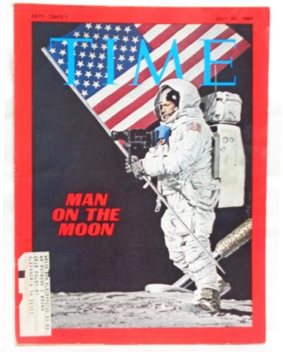

Slide 4
1968 - 1970
1968 | State Planning Office created within Executive Department
1969 | “Design with Nature” by Ian McHarg published
1969 | Maine Constitution amended to provide for broad home rule authority for towns and cities

Slide 5
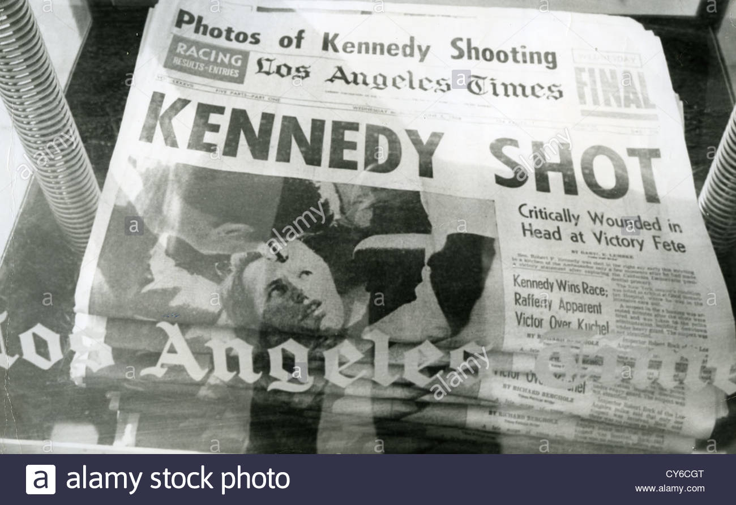
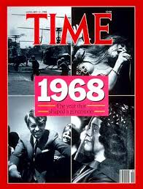
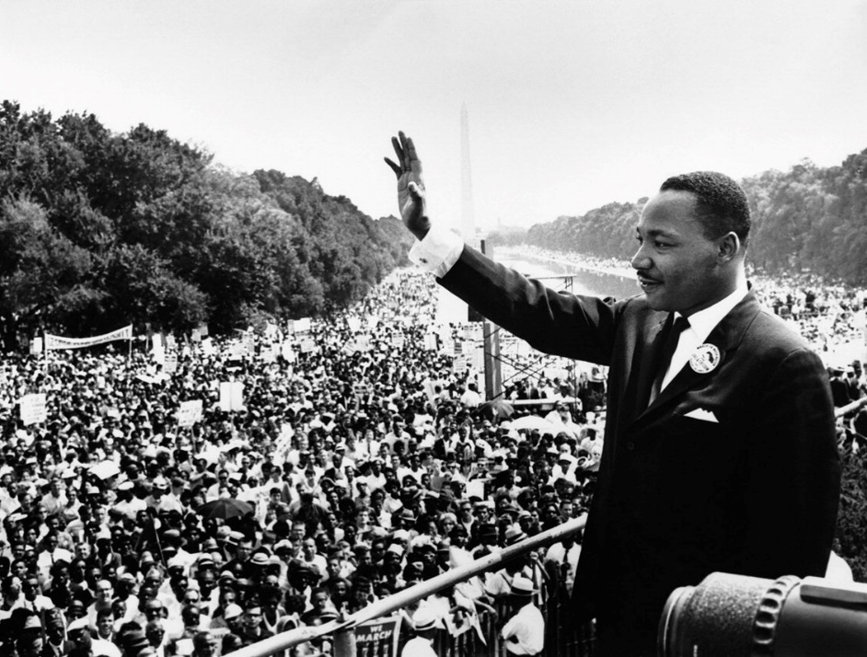
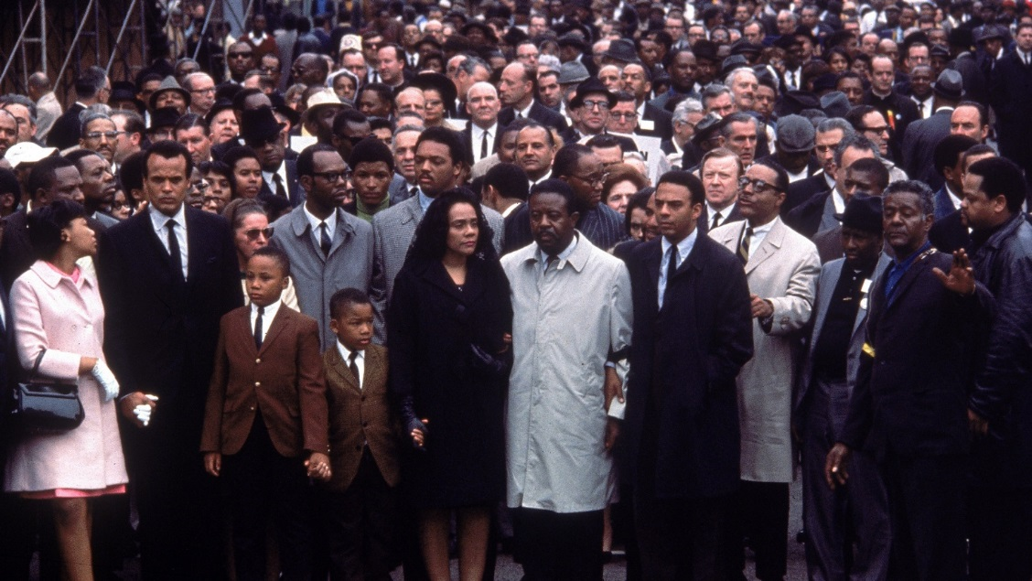

Slide 6
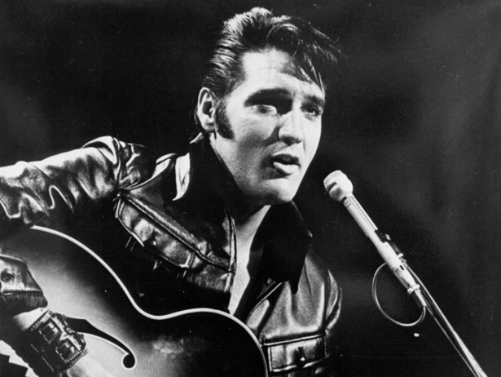

Slide 7
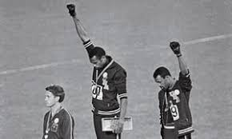
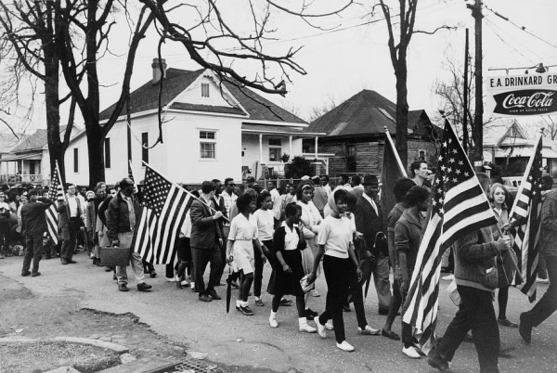

Slide 8
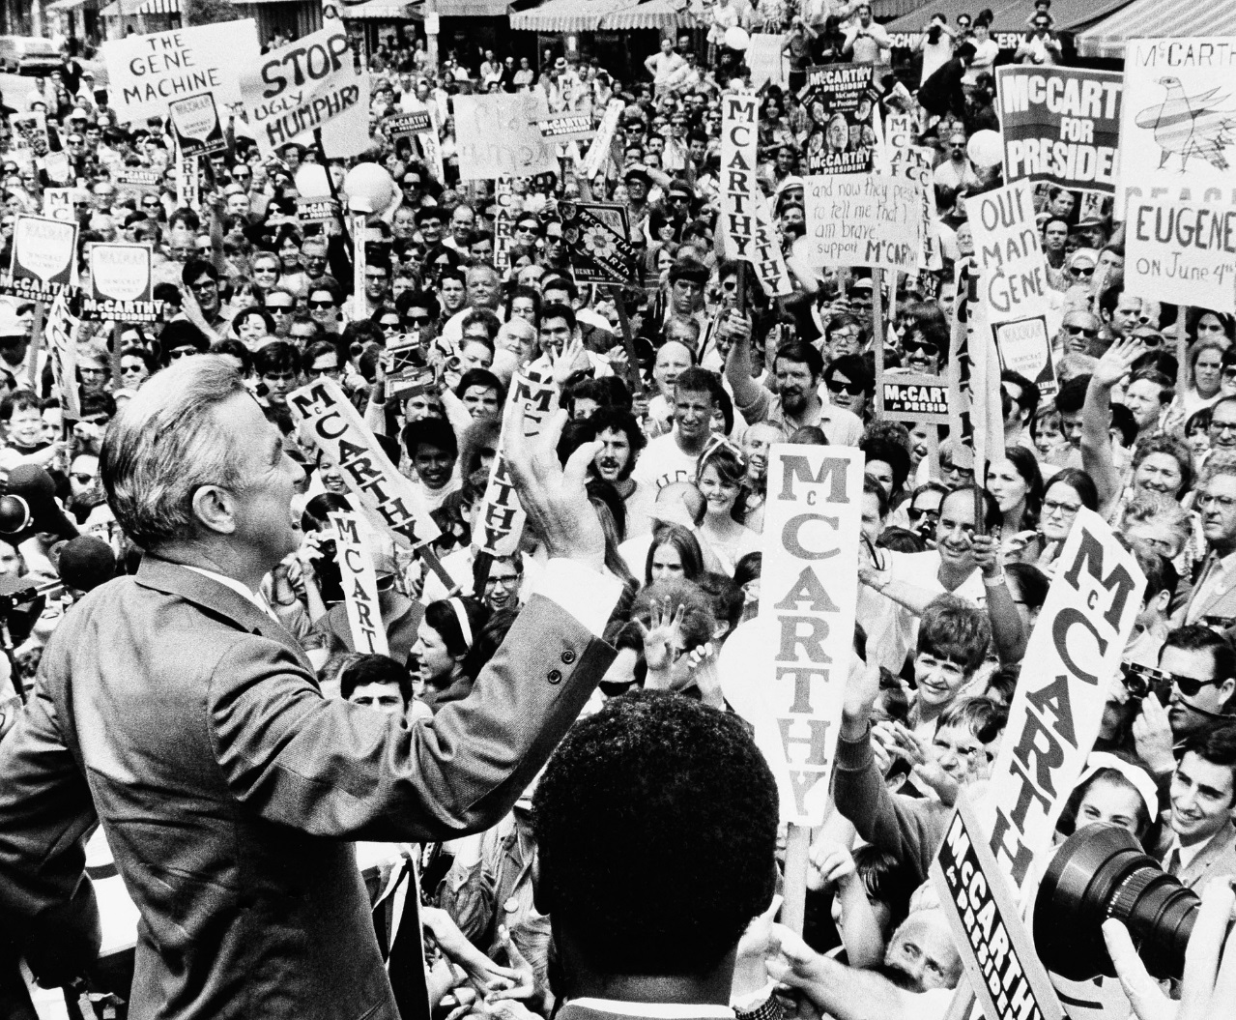
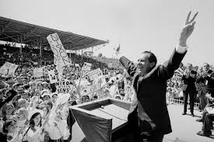

Slide 9
There have been many members of the Maine Association of Planners. Some have even served as officers and board members. To those folks who went above the call of duty, we thank you for a great 50 years!

Slide 10
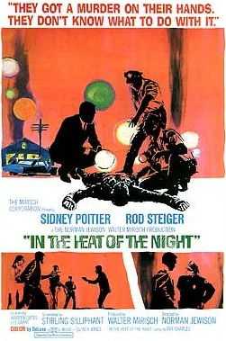
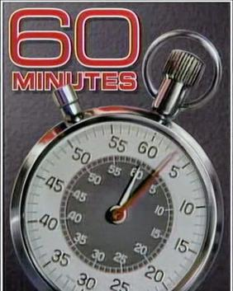

Slide 12
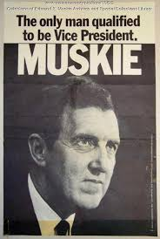
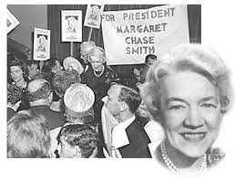
Margaret Chase Smith – US Congress
Edmund Muskie – US Congress

Slide 13
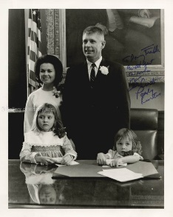
1968 Governor of Maine
Kenneth Curtis
State Planning Office created

Slide 14
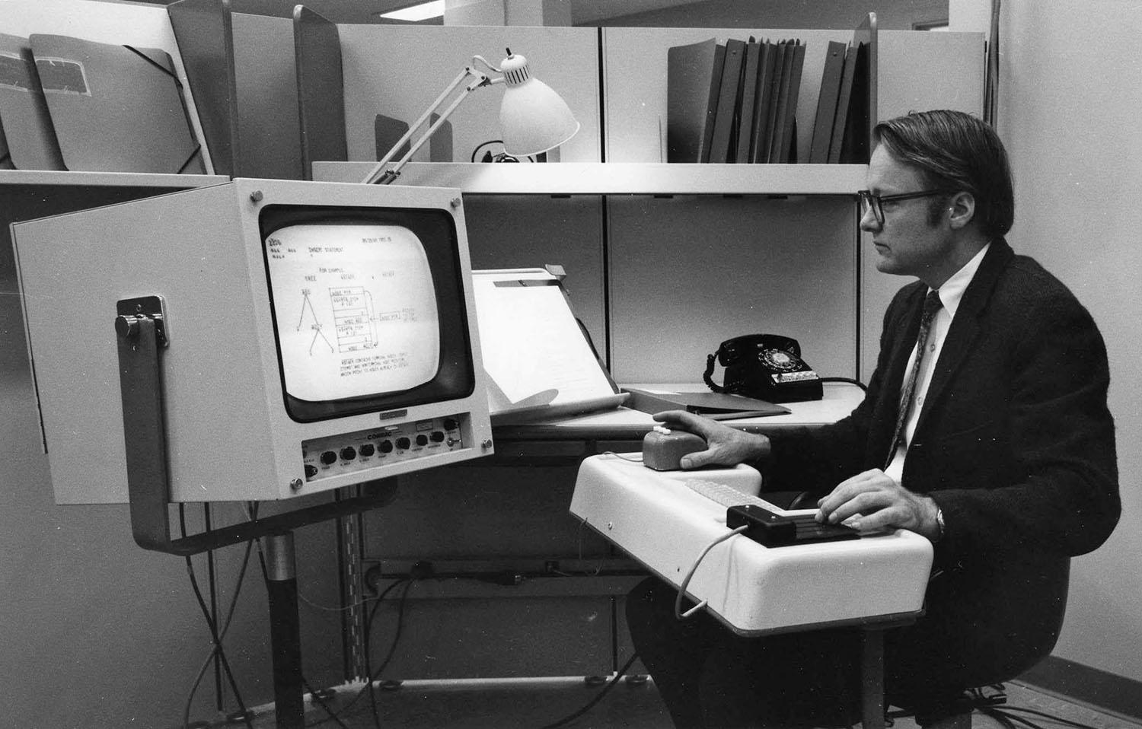
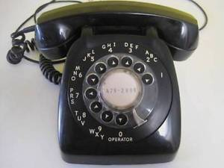

Slide 15
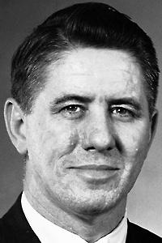
Allen Gardner Pease early Maine state planning director

Slide 16
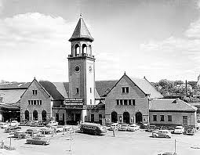
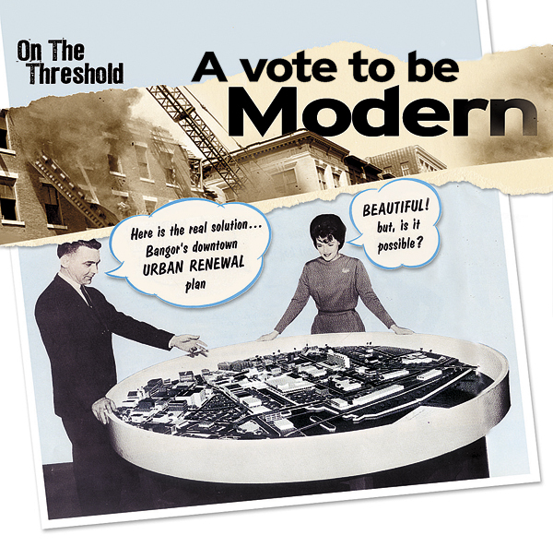
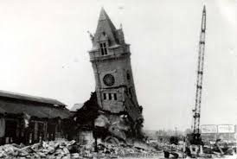

Slide 18
1970’s
1971 | Maine Legislature establishes the Land Use Regulation Commission to plan and zone the Unorganized Territory
1971 | Maine Legislature adopts Mandatory Shoreland Zoning Act
1971 | Maine recognized as part of “The Quiet Revolution in Land Use Control: by the U.S. Council on Environmental Quality
1972 | Maine Legislature renames the Environmental Improvement Commission as the Board of Environmental Protection and creates the Department of Environmental Protection
1972 | Congress enacts Coastal Zone Management Act, leading to establishment of Maine Coastal Zone Management Program within State Planning Office

Slide 19
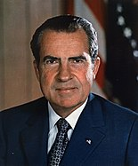
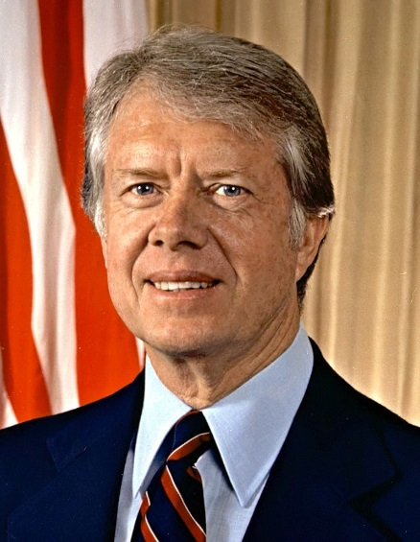
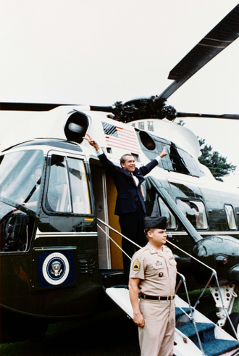
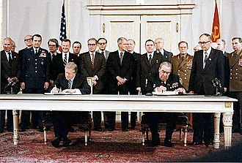

Slide 20
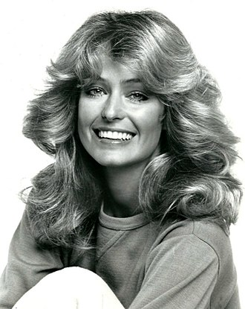
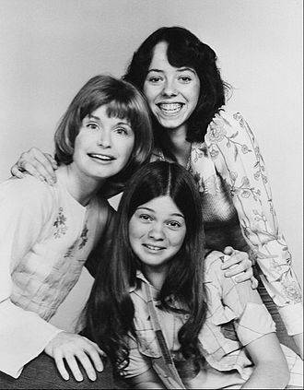
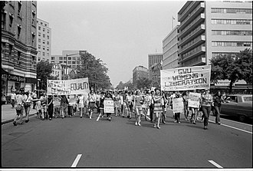

Slide 21
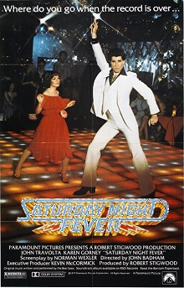
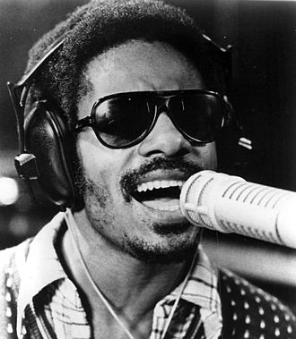
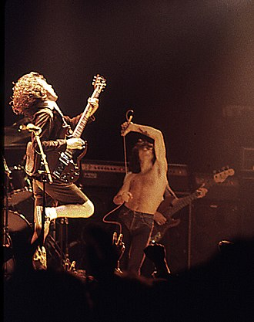

Slide 22
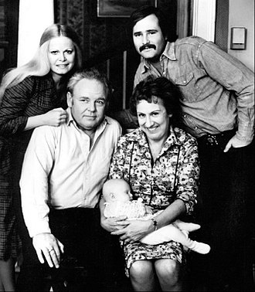
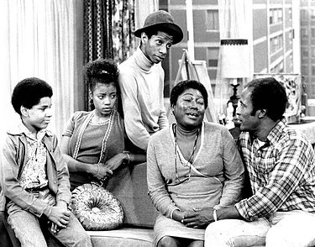

Slide 24
1980 -1990’s
1982 | Maine Rivers Act adopted, classifying the state’s rivers and streams
1987 | Land for Maine Futures Program established within State Planning Office, with $35 million bond approved at referendum
1988 | Maine Legislature adopts Natural Resources Protection Act, consolidating individual natural resource protection laws
1988 1991 1992 | Maine Legislature adopts Comprehensive Planning and Land Use Regulation Act, aka Growth Management Program, overhauling the state’s planning and zoning enabling legislation and requiring local comprehensive plans and related local land use regulation, with financial assistance Maine Legislature, facing financial crisis as result of recession, de-appropriates comprehensive planning funds for municipalities, removes mandatory aspects of the Growth Management Program Maine Legislature restores some required elements of comprehensive planning; comprehensive plans still prerequisite for zoning ordinances
1997 | State Planning Office publishes “Cost of Sprawl”
1998 | State Planning Office publishes “Reviving Regional Service Centers” as part of first urban policy for Maine, leading to rule formally designating “regional service centers”

Slide 25
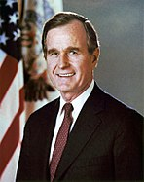
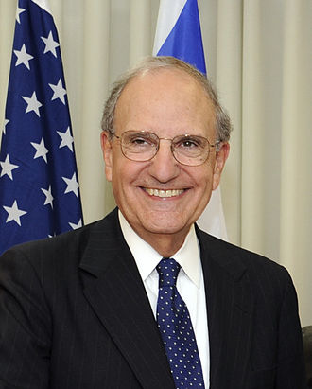
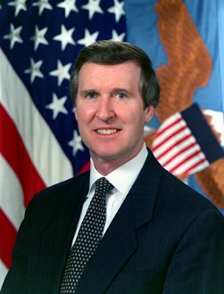
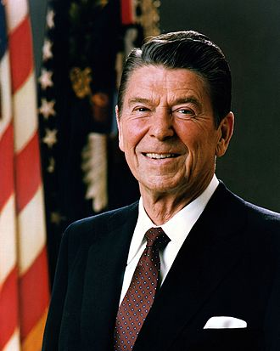
George Bush - President
US Congress – George Mitchell and William Cohen
Ronald Reagan – President

Slide 26
Thank you previous MAP Board members:
1981
Mark Eyerman, Chairman
Susan Bogle-Krauss, Vice-Chairman
Rich Rothe, Secretary – Treasurer
Rodney Lynch, Newsletter Editor
Gore Flynn, Director

Slide 27
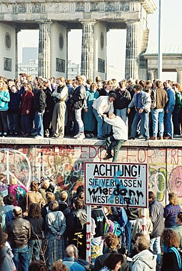
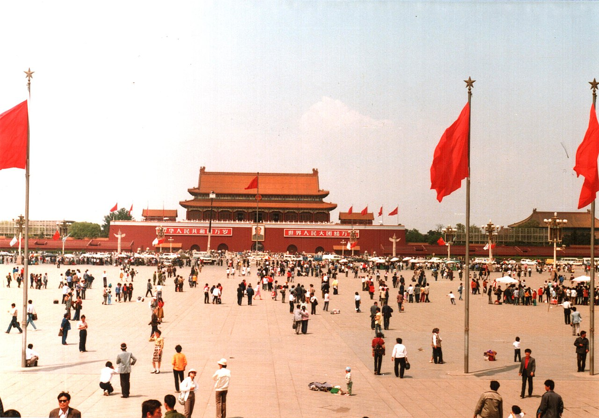

Slide 28
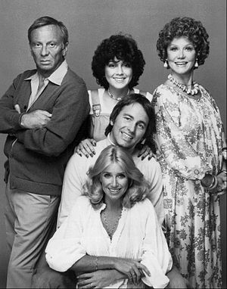
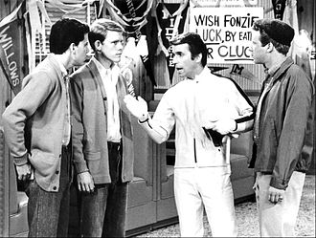
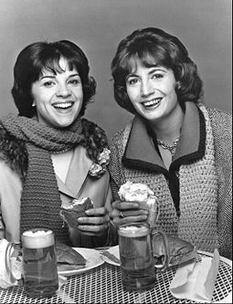

Slide 29
Thank you previous MAP Board members:
1980’s
Donald Meagher, President
Rodney Lynch, Treasurer
Joyce Benson, Secretary – Treasurer
Charles Watson, Vice President
Teco Brown, Board
Jacqueline Cohen, Board
Alex Jaegerman, Board

Slide 30
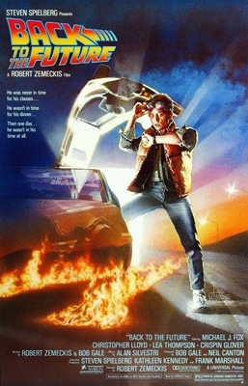

Slide 31
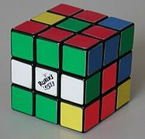
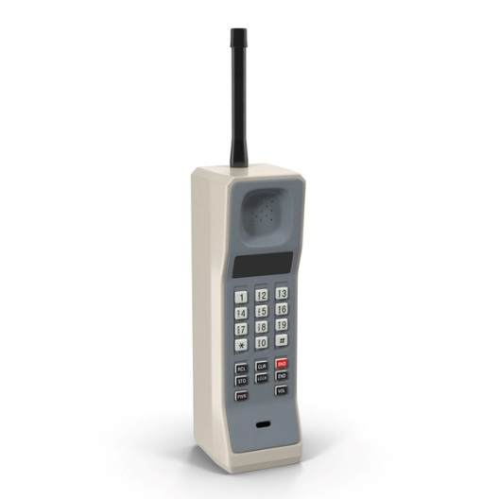
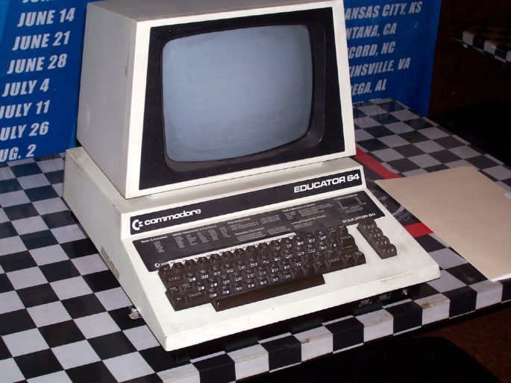

Slide 32
Thank you previous MAP Board members:
1980’s
Elery Keene, Director
Richard Barringer, Director
Robert Thompson, Director
Arthur Lerman, Director
Joe Young, Awards chair
Ramean Armajani, Board
Bo Yerxa, Board
Steve Butler, Board
Jeff Jordan, Board

Slide 33
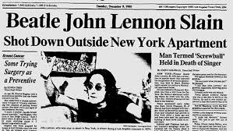
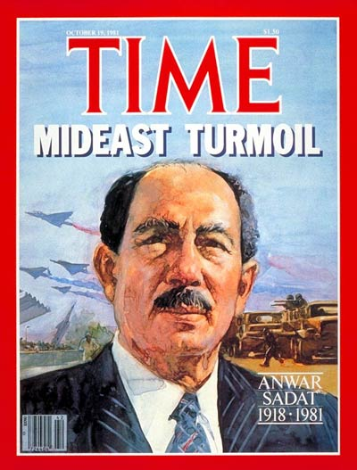
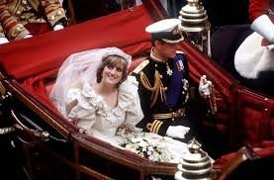
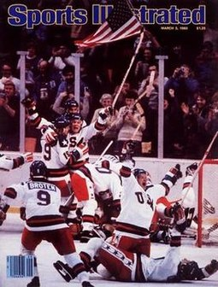

Slide 34
Thank you previous MAP Board members:
1980’s
Jonathan Lockman, Board Member
Steve Westra, Treasurer
Joan A. Walton, AICP, Treasurer 1995-1999
Ed Heath, President and Treasurer 1993-1994
Kathy Fuller, Vice President/Legislative Liaison
Judy Bernstein, Legislative Liaison
Steve Tuckerman, Secretary

Slide 36
William Clinton –
President
US Congress
Susan Collins and Olympia Snowe
George Bush - President

Slide 37
Thank you previous MAP Board members:
1980’s
Paula Thompson, Treasurer
Steve Westra, Newsletter Editor
Jim Brown, Membership Secretary
Theresa Stellpflug, Awards Committee chair
Mary Ann Hayes
Anthony Dater
Ann Beverage
Jim Upham
R. Collin Therrien
George Dycio
Debra Fossum

Slide 40
Thank you previous MAP Board members:
1980’s
Steve Tuckerman, Secretary
Paula Thompson, Treasurer
Steve Westra, Newsletter Editor
Jim Brown, Membership Secretary
Theresa Stellpflug, Awards Committee chair
Mary Ann Hayes

Slide 43
Thank you previous MAP Board members:
1980’s
Anthony Dater
Ann Beverage
Jim Upham
R. Collin Therrien
George Dycio
Debra Fossum

Slide 47
2000’s
2003 | GrowSmart Maine founded; CPD program established at USM/Muskie Institute
2004 | Maine court for first time (and to date only time) uses Growth Management Program statute to uphold a development plan (Dunstan Crossing) prescribed in a town comprehensive plan against zoning provisions found inconsistent with the comprehensive plan (ALC Development Corp. v Town of Scarborough)
2010 | Town of Standish adopts a form-based code based on traditional neighborhood development principles
2012 | Land Use Regulation Commission statute modified, LURC re-named Land Use Planning Commission
2012 | Gov. LePage eliminates Maine State Planning Office, distributing its functions among other agencies, including Growth Management Program and Coastal Zone Program to Dept. of Agriculture, Conservation and Forestry

Slide 49
Thank you previous MAP Board members:
2000
Jonathan Lockman, President
Fred Marshall, Treasurer
Matt Nazar

Slide 50
Presidents – George Bush, Barack Obama, Donald Trump
US Congress – Angus King and Susan Collins

Slide 51
Thank you previous MAP Board members:
2002
David Schmidt (President)
Jim Fisher
Sarah Flaks
Noel Musson
Doug Webster
Jean Marshall
Maureen O'Meara
Fred Marshall
Matt Nazar
Theresa Oleksew

Slide 53
Thank you previous MAP Board members:
2004
Jim Fisher, President
Noel Musson, Vice President
Fred Marshall, Treasurer
Doug Webster, Secretary
Mat Nazar, Membership Secretary
Ann Krieg
David Galbraith
Jean Marshall
Maureen O’Meara
Theresa Oleksiw
Rich Roedner
Hugh Cox

Slide 54
Thank you previous MAP Board members:
2003
Jim Fisher (President)
Matt Nazar
Doug Webster
Fred Marshal
Maureen O'Meara
David Sanborn
Sarah Flaks
Karen Martin
Noel Musson
David Galbraith
Theresa Oleksiw
Jean Marshall
David Schmidt

Slide 55
Thank you previous MAP Board members:
2005
Noel Musson President
Hugh Coxe
Beth DellaValle
Jim Fisher
Rich Roedner
Maureen O’Meara
Linda Johns
Fred Marshall
Matt Nazar
Jean Marshall
Stacy Benjamin

Slide 57
Thank you previous MAP Board members:
2006
Tom Marcotte
Stacy Benjamin
Linda Johns
Jim Fisher
Noel Musson
Beth Della Valle
Maureen O’Meara
Rebeccah Schaffner
Hugh Cox
Fred Marshall
Helen Edmonds
Josh McDonald
Carl Eppich

Slide 58
Thank you previous MAP Board members:
2007
Noel Musson, President
Jim Fisher
Hugh Coxe
Rebecca Schaffner
Judy East
Carl Eppich
Maureen O’Meara
Beth Della Valle
Helen Edmonds
Kathleen Leydon
Jane Lafleur
Linda Johns
Stephen Condon
Anne Krieg

Slide 59
Thank you previous MAP Board members:
2008
Maureen O’Meara – President
Beth Della Valle – VP
Fred Marshall - Treasurer
Jim Fisher – Secretary, Membership, Web
Rebecca Schaffner – Newsletter Editor
Noel Musson
Stacy Benjamin
Hugh Coxe
Helen Edmonds
Carl Eppich
Linda Johns
Anne Krieg
Jane Lafleur
Judy Colby-George
Steve Condon

Slide 61
Thank you previous MAP Board members:
2009
Maureen O’Meara, President
Beth Della Valle, VP
Fred Marshall, Treasurer
Linda Johns, Recording Secretary
Helen Edmunds
Rebecca Schaffner
Stacy Benjamin Jane Lafleur
Hugh Coxe
Anne Krieg
Mac Stocco

Slide 62
Thank you previous MAP Board members:
2010
Beth Della Valle, President
Carol Eyerman, Vice President
Fred Marshall, Treasurer
Judy East, Membership Secretary
Tex Haeuser, Legislative Policy chair
Rebecca Schaffner
Stacy Benjamin
Judy Colby-George
Rod Melanson

Slide 64
Thank you previous MAP Board members:
2011
Beth Della Valle, President
Carol Eyerman, Vice President
Fred Marshall, Treasurer
Judy East, Membership Secretary
Tex Haeuser, Legislative Policy chair
Rebecca Schaffner
Stacy Benjamin
Judy Colby-George
Rod Melanson

Slide 66
Thank you previous MAP Board members:
2012
Beth Della Valle, President
Lynne Seeley, Vice President
Fred Marshall, Treasurer
Jessa Berna, Website Administrator
Judy East, Membership Secretary
Misty Gorski, Newsletter Coordinator
Tex Haeuser, Legislative Policy chair
Evan Richert, Recording secretary
Stacy Benjamin
Ethan Croce
Sarah Curran
Andrew Deci
Jay Kamm
Amanda Lessard
Rod Melanson

Slide 68
Thank you previous MAP Board members:
2016
Carol Eyerman, President
Lynne Seeley, Vice President
Phil Carey, Treasurer
Ethan Croce, Recording Secretary
Amanda Lessard, Membership Secretary/Awards
Sarah Curran, Past President
Amanda Bunker
Anne Krieg
Jamie Francomano
Mark Lapping
Tom Martin
Carl Eppich
Jamel Torres

Slide 70
Thank you previous MAP Board members:
2017
Carol Eyerman, President
Lynne Seeley, Vice President
Ethan Croce, Recording Secretary
Jim Fisher, Membership Secretary/Awards
Sarah Curran, Past President
Amanda Bunker
Anne Krieg
Jamie Francomano
Mark Lapping
Tom Martin
Carl Eppich
Jamel Torres
Hugh Coxe
Samantha Horn-Olsen

Slide 72
Thank you to the current Board:
2018
Carol Eyerman, President
Lynne Seeley, Vice President
Jane Lafleur, Treasurer
Samantha Horn, Recording Secretary
Jim Fisher, Membership Secretary/Awards
Amanda Bunker, Conference Planning
Anne Krieg
Mark Lapping
Carl Eppich
Jamel Torres
Jerod Woolston

Slide 73
Maine Association of Planners
The Future Awaits

